Slide 1
WAVES

Slide 2
Introduction
In this chapter we will see the importance of waves in our lite.
We will also study about the different properties of waves, some terms related to waves and also about different types of waves. We will also learn how waves propagate.
For example: -
Medium required by the waves to travel from one point to another:*
Consider a boy holding a thread and one end of thread is tied to the wall.
When a boy moves the thread, the thread moves in the form of a wave.

Slide 3

similarly a boat sailing over the sea, the boat is able to move because of waves.
The ripples formed in a lake when we drop a stone in the lake. They are also waves.
Earthquakes are caused due to the waves under the surface of the earth.

Slide 4

The strings of the guitar when we play them are also waves again.
Music system which we use to hear songs. This is due to sound waves.
when 2 people talk they are able to hear each other because of the sound waves.
In the below Picture we can see waves need a medium to propagate.
Medium not required by some type of waves to move from one point to another:-
TV remote waves play important part.
Satellite shelpustouse TV, mobile phones, music system, the sun. the traffic lights, microwave. x-rays.

Slide 5


Some type of waves can propagate from one point to another without any medium. Waves which are related to matter:-
There are some set of waves which are inside the matter,
For example: - whole of universe.

Slide 6
What is a wave?
A wave is s disturbance that propagates through space and time. usually with transference of energy.
For example: -
Consider the sound of the horn: this sound reaches our ear because of sound waves.
There is transfer of energy from one point lo another with the help of particles in the medium.
These particles don't move they just move around their mean position, but the energy is getting transferred from one particle to another and it keeps on transferring till it reaches the destination.

Slide 7
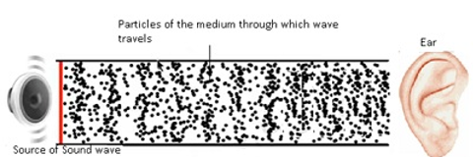
The movement of a particle is initiated by the disturbance. And this disturbance is transferred from one point to another through space and time.
Note : Energy and not the matter is transferred from one point to another.
When a source of energy causes vibration to travel through the medium a wave is created.

Slide 8
Types of Waves
Mechanical waves
Electromagnetic waves
Matter waves
Mechanical waves:
The mechanical waves are governed by all the Newton's laws of motion. Medium is needed for propagation of the wave.
For Example : - Water Waves. Sound Waves
Water waves : They are mechanical waves for which a medium is required to propagate.

Slide 9
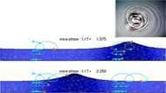
Sound waves: A guitar or music system. Sound waves need a medium to propagate. They cannot travel in vacuum.

Slide 10

Electromagnetic Waves
Electromagnetic waves are related to electric and magnetic fields.
An electromagnetic wave, does not need a medium to propagate, it carries no mass, does carry energy.
Examples: • Satellite system, mobile phones radio, music player, x-rays and microwave.

Slide 11
Matter waves:
Waves related to matter. Matter consists of small particles.
Matter waves are associated with moving electrons, protons, neutrons & other fundamental particlesete.
It is an abstract concept.
Examples: - pencil, sun, moon, earth, ball, atoms.

Slide 12

Transverse Waves
The transverse waves are those in which direction of disturbance or displacement in the medium is perpendicular to that of the propagation of wave
The direction in which a wave propagates is perpendicular to the direction of disturbance.

Slide 13
For example:-
Consider a manholding one end of a thread and other end of the thread is fixed to wall.
When a little jerk is given to the thread in the upward direction. The entire thread moves in a wavy manner.
The jerk propagated along the entire length of the thread.
The small disturbance which came from the source at one end. that disturbance getting propagated and that is known as direction of propagation,
Disturbance is vertically upward and wave is horizontal. They are perpendicular to each other.
This type of wave is known as transverse wave.

Slide 14

Transverse Waves
This type of wave is known as transverse wave
A single pulse is sent along a stretched string. A typical element of the string (suchas that marked with a dot) moves up and then down as the pulse passes through.
The element's motion is perpendicular to the direction in which the wave travels.

Slide 15
How are transverse waves caused?
When we pull a thread in upward direction the formation and propagation of the waves are possible because entire thread is under tension.
This tension is the small disturbance which is given at one end and it gets transferred to its neighbouring molecules,
This will keep on continuing.so this small pulse will get propagated along the length of the thread.
The movement of the particles is perpendicular to the propagation of the wave and the wave will propagate horizontally.

Slide 16
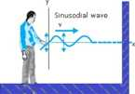
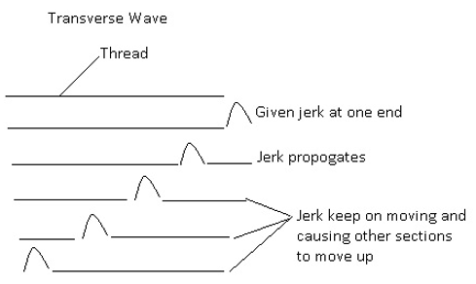
Transverse Waves
It is a transverse wave.
A sinusoidal wave is sent along the string. A typical element of the string moves up and down continuously as the wave passes.

Slide 17
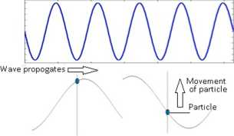
Transverse Waves
Conclusion :
Transverse waves are those waves which propagates perpendicular to the direction of the disturbance.
Direction of disturbance is the direction of motion of particles of the medium.
Transverse Wave
Particles are moving up and down around their mean position.

Slide 18
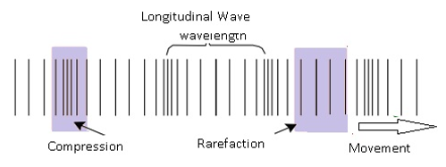
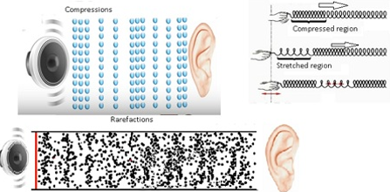
Longitudinal Waves
Longitudinal Wave
Longitudinal means something related to length.
In longitudinal waves direction of disturbance or displacement in the medium is along the propagation of the wave.

Slide 19


Longitudinal Waves
For example: - Sound waves. Particles and wave moving along the horizontal direction. So both are in the same direction.
In a Longitudinal wave there are regions where particles are very close to each other. These regions are known as compressions.
In some regions the particles are far apart. Those regions are known as are factions.
Differentiate between transverse and longitudinal waves
Transverse | Longitudinal
Constituents of the medium oscillate perpendicular to the direction of the wave propagation. | Constituents of the medium oscillate parallel to the direction of wave propagation.

Slide 20
Progressive Waves
Displacement In a progressive wave
Amplitude and phase together describe the complete displacement of the wave.
Displacement function is a periodic in space and time.
Displacement of the particles in a medium takes place along the y-axis.
Generally displacement is denoted as a function of X and T. but here it is denoted by y.
In case of transverse wave displacement is given as:
y(x, t) where x=propagation of the wave along x-axis. and particles oscillates along y-axis.
Therefore y(x, t) = A sin(kx - ωt + ϕ).This is the expression for displacement.
This expression is same as displacement equation which is used in oscillatory motion.
As cosine function; y (x, t) = B cos (kx - ωt + ϕ), As both sine and cosine function)y (x, t) = A sin (kx - ωt + ϕ) + B cos (kx - ωt + ϕ)

Slide 21

Mathematically:
Wave travelling along + X-axis: y(x. t) = a sin (kx - ωt + ϕ).
Consider y = a sin (kx - ωt + ϕ) => y/a = sin (kx - ωt + ϕ)
Sin⁻¹ (y/a) = kx - ωt => kx = sin⁻¹ (y/a) + ωt
x = (1/k) sin⁻¹ (y/a) + (ωt/k)
wave travelling along -X-axis: x = (l/k) sin⁻¹ (y/a) - (ωt/k) (only change in the sign of ωt)
Conclusion:-
As time t increases the value of x increases. This implies the x moves along
x-axis.
As time t decreases the value of x decrease. This implies the x moves along
(-)ive x-axis.

Slide 22
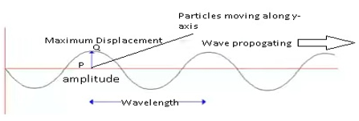
Amplitude And Phase
Amplitude and phase together describes the position of the particle.
Amplitude is the maximum displacement of the elements of the medium from their equilibrium positions as wave
passes through them,
It is denoted by A.
In case of transverse wave.
The distance between the point P and 0 (in the Figure) is maximum displacement. This maximum displacement of the particles is known as amplitude.

Slide 23
In case of longitudinal wave.
There are regions of compressions (particles are closely packed) and are factions (particles are far apart),
In compressions density of the wave medium is highest and in rarefactions density of the wave is lowest.
Consider when the particle is at rarefaction, in that region as particle gets more space as a result the particles oscillates 10 We maximum displacement.
Whereas in compressed region the particles oscillates very less at the space is not very much
The peak or the maximum amplitude centre of two compressed region. Because at the centre of the two compressed region the particle is most tree to displace to maximum displaced position.

Slide 24
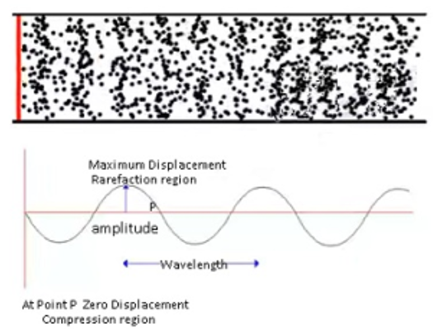
Conclusion :
In case of longitudinal wave the particles will not oscillate to a very large distance. This displacement won’t represent the amplitude as it is not maximum possible displacement.
Amplitude is represented basically by the centre of the rarefaction region where the particle is most free to oscillate to its maximum displacement.

Slide 25

PHASE
Phase of a wave describes the state of motion as the wave sweeps through an element at a particular position.
In-phase- Two points are said to be in-phase with each other when these two points are at the same position and they both are doing the same thing i.e. both the two points are exhibiting the same behaviour.
Points C and F are in phase with each other.
Out-of-phase
Two points are said to be out of phase even though they are at the same points but they are doing opposite thing i.e both the points are exhibiting the different behaviour,

Slide 26

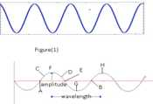
Out of phase means which is not in phase.
Points 8 and D,E and G are out of phase by 180°
Two waves can be completely in phase or out of phase with each other They can be partially m phase or out of phase with each other
Observations made from the figure (1)

Slide 27
Consider two points A and B on a wave. Their positions as wen as their behanout are same. Therefore points A and B are m phase
Consider points A and C on a wave. They are not in phase with each other as then position is not same.

Slide 28
Expression of Phase
y(x, t) = asin (kx - ωt + ϕ) where
a = amplitude, (kx - ωt + ϕ) = phase
k = wave number,
x - displacement of wave along x - direction.
w = angular frequency
t = time
ϕ = lnitial phase angle.
Initial Phase angle
Initial phase angle is defined as phase under initial conditions (t = 0).
Denoted by ϕ.
It determines the angle between the starting position and the original
Consider the figure (1) the starting point is 0.i.e. ϕ = 0
In figure (2) as it is not starting from 0. therefore ϕ = π/2.
Similarly in figure (3) ϕ = n.

Slide 29
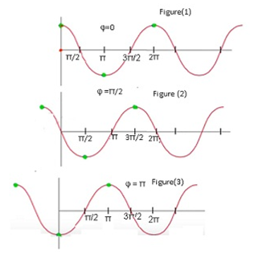
So the initial phase angle determines from where the observation starts,
Taking ϕ = 0 does not affect any nature or properties of the wave.

Slide 30
Wavelength
The term wavelength means length of the wave.
wavelength is defined as the minimum distance between two consecutive points in the same phase of wave motion.
It is denoted by λ.
In case of transverse wave we use the term crest tor the peak of the maximum displacement.
The point of minimum displacement Is known as trough
In case of transverse wave wavelength is the distance between two consecutive crests or distance between two consecutive troughs.

Slide 31
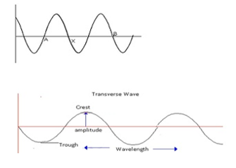
In case of longitudinal wave wavelength is the distance between the two compressions or the distance between the two rarefactions provided the compressions or rarefactions are nearest.

Slide 32
Problem: A bat emits ultrasonic sound of frequency 1000 kHz in air. If the sound meets a water surface, what is the wavelength of (a) the reflected sound, (b) the transmitted sound? Speed of sound in air is 340m s and in water 1486m s⁻¹
Answer: Frequency of the ultrasonic sound, v = 1000 kHz = 10⁶ Hz Speed of sound in air. v_{a} = 340 m/s
The wavelength (A() of the reflected sound is given by the relation:
λ_{r} = v_{a} / v = 340/10⁶ = 3.4 x 10⁻⁴ m
Frequency of the ultrasonic sound, v = 1000 kHz = 10⁶ Hz
Speed of sound in water, V_{w} = 1486 m/s
The wavelength of the transmitted sound is given as:
λ_{r} = 1486/10⁶ = l.49 x 10⁻³ m

Slide 33

Problem : A hospital uses an ultrasonic scanner to locate tumours in a tissue. What is the wavelength of soundin the tissue in which the speed of sound is 1.7 km s⁻¹? The operating frequency of the scanner is 4.2 MHz
Answer : Speed of sound in the tissue, v = 1.7 km/s = 1.7 x 10³ m/s
Operating frequency of the scanner, v = 4.2 MHz = 4.2 x 10⁶ Hz.
The wavelength of sound in the tissue is given as:
λ = v/v
= (1.7 x 10³) / (4.2 x 10⁶)
= 4.1 x 10⁴

Slide 34
Wave Number
Wave Number
Wave number describes the number of wavelengths per unit distance.
Denoted by 'k’
y (x, t) = a sin (kx - ωt + ϕ) assuming ϕ = 0.
At initial time t = 0
y(x, 0) = asin kx (i)
When x = x + λ then y(x + λ, 0) = a sink (x + 2λ)
When x = x + 2λ then y(x + 2λ, 0) = a sink (x + 2λ)
Value of y is equal at all points because all the points’ λ, 2λ are in phase with each other. Therefore.
From(i) and (ii) asin kx = a sink (x + λ) = asin(kx - kλ)
This is true if and only if: -kλ = 2 πn. where n = 1, 2.3…
k = (2 π n)/ λ. This is the expression tor wave number
k is also known as propagation constant because it tells about the propagation of the wave. Wave number Is an Indirect way of describing the propagation of wave.

Slide 35
RELATION BETWEEN TIME PERIOD,FREQUENCY AND ANGULAR FREQUENCY
Time Period, Frequency and Angular frequency
Time Period of a wave: -
Time Period of a wave is the time taken through one complete oscillation. It is denoted by ‘T’.
Frequency of a wave:-
Frequency of a wave is defined as number of oscillations per unit time. lt is denoted by v. V = 1/T.
Angular frequency:
Angular frequency is defined as the frequency of the wave in terms of a circular motion.
The term angular frequency is used only when there is an angle involved in the motion in that particular motion.
It is denoted by V.

Slide 36
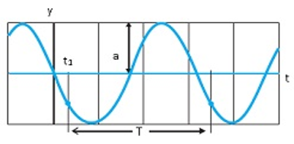
For example:-ln linear motion angular frequency is not used but in case of wave the term angular frequency is used,
Relation of with w frequency v is given ω = 2πvorω = 2π/T.
A graph of the displacement of the string element at x = 0 as a function of time, as the sinusoidal wave passes through it. The amplitude a is indicated. Atypical period T, measured from anarbitrary time t₁ is also indicated.

Slide 37
3. Problem:- A wave travelling along astring is described by, y(x, t) = 0.005 sin (80.0 x - 3.0 t), in which the numerical constants are in SI units (0.005 m, 80.0 rad m⁻¹, and 3.0 rad ^{s-1}). Calculate (a) the amplitude,(b) the wavelength, and (c) the period and frequency of the wave. Also, calculate the displacement y of the wave at a distance x = 30.0 cm and time t = 20 s?
Answer- Applying displacement equation,
y (x, t) = a sin (kx - wt),
we find(a) (he amplitude of the wave is 0.005 m = 5 mm. (b) the angular wave number k and angular frequency w arek = 80.0 m⁻¹ and w) = 3.0 s⁻¹
l = 2p/k = (2 pt)/ (80.0)m⁻¹
= 7.85 cm
(c) Now we relate T tow by the relation
T = 2p/w = (2p)/ (3.0) s⁻¹

Slide 38
Frequency. v = t/T = 0.48 Hz.
The displacement y at x = 30.0 cm and time t = 20 sis given by
y = (0.005 m) sin (80.0 x 0.3 - 3.0 x 20)
= (0.005 m) sin(-36 x 12π)
= (0.005 m) sin (1.699)
= (0.005 m) sin (97°)
-5 mm

Slide 39
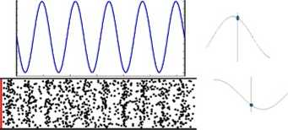
Travelling Waves
Travelling waves are those waves which travel from one medium to another.
They are also known as progressive wave. Because they progress from one point to another.
Both longitudinal and transverse waves can be travelling wave.
Wave as a whole moves along one direction.

Slide 40
The speed of a travelling wave
To determine the speed of a travelling wave.
The propagation of the wave always takes place along the +(ive)
x-axis.
It is denoted by v.
Consider transverse wave moving along (+) ive x axis.
Displacement equation y (x, t) = a sin (kx - wt) assuming ip = 0.
In case of transverse wave the y denotes the movement of particles along y-axis. x denotes the direction of wave propagation in terms of
x axis.
y-axis denotes the displacement of the particles of the medium in case of transverse wave and in case of longitudinal wave x denotes the movement of the particles along x-axis.
In case of longitudinal wave the motion of particles takes place along x-axis and not along y-axis.

Slide 41
The form of equation remains the same for both transverse and longitudinal wave.
Only the direction of propagation i.e. the direction of the movement of the particles differs in case of transverse and longitudinal waves.
We have considered only the motion along the horizontal direction i.e. x-axis. i.e. motion of all the peaks and which is amotion of a straight line.
Displacement takes place along the straight line along x-axis.

Slide 42
Travelling Waves
We have considered only the motion along the horizontal direction i.e.
x-axis. i.e. motion of all the peaks and which is a motion of a straight line,
Displacement takes place along the straight line along x-axis.
y component does not play much role as it talks about the movement of particles of the medium.
when we are considering the peaks as a result phase does not have any role. That is phase is constant.
y/a=sin(kx - ωt) => sin⁻¹ (y/a) = (kx - ωt)
=> x = (1/k) sin⁻¹ (y/a) + ωt/k (where (1/k)sin⁻¹ (y/a) is constant)
=> Speed V > dx/dt - ω/k
(By differentiating with time. (i/k)sin⁻¹(y/a)=0 as differentiating a constant term is 0.)
Therefore Wave Speed V = ω/k where ω angular frequency and k = wave number.

Slide 43
Different Expressions for Wave Speed
wave speed V-ω/k. By definition of ω = (2π)/T where
T is period of the wave,
Also k = (2 π)/λ. Therefore v = (2 π)/(T)/(2 π)/(λ) = λ/T
V = λv
As wavelength of a wave increases as a result frequency of the wave decreases as a result speed of wave is constant.
wave speed is determined by the properties of the medium.

Slide 44
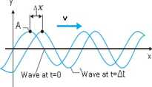
The plots of y (x, t) = a sin (kx - ωt + ϕ) at two instants of time differing by an interval At, at t = 0 and then at t = Δt. As the wave moves to the right at velocity v, the entire curve shifts a distance Ax during At. The point A rides the waveform but the string element moves only up and down.

Slide 45

Speed of a transverse wave in a stretched string
Consider a stretched string and if given transverse disturbance on one end then the disturbance travels throughout the string.
Thereby giving rise to transverse waves.
The particles move up and down and the waves travel perpendicular to the oscillation of the particles.
Transverse wave speed determined by:
Mass per unit length- As mass gives rise to Kinetic energy. If no mass then o kinetic energy. Then there will be no velocity.
It is denoted by μ.
Tension-Tension is the key factor which makes the disturbance propagates along the string,
Because of tension the disturbance travels throughout the wave.
It is denoted by T.

Slide 46
Speed of a transverse wave
Dimensional Analysis to show how the speed is related to mass per unit length and Tension
μ = [M]/[L] = [ML⁻¹] (i)
T = F = ma = [M][LT⁻²] = [MLT²] (ii)
Dividing equation (i) by (ii):- [ML⁻¹]/[MLT⁻²] = L²T²=[T/L]² = [TL⁻¹]² = =1/v²
Therefore μ/T = 1/v²
v = C/T/ μ where C = dimensionless constant
Conclusion: v depends on properties of the medium and not on frequency of the wave.

Slide 47
4. Problem:- A steel wire 0.72 m long has a mass of 5.0 x10⁻³ kg. If the wire is the a tension of 60 N, what is the speed of transverse waves on the wire?
Answer: Mass per unit length of the wire,0.72 m
μ = 5.0 x 10⁻³ kg
= 6.9 x 10⁻³ kgm⁻¹
Tension, T = 60 N
The speed of wave on the wire is given by, v = C\T/p
(60)/ (6.9 x 10⁻³ kgm⁻¹) = 93 ms⁻¹

Slide 48
Numerical
5. Problem:- A string of mass 2.50 kg is under a tension of 200 N. The length of the stretched string is 20.0 m. If the transverse jerk is struck at one end of the string, how long does the disturbance take to reach the other end?
Answer:-
Mass of the string, M = 2.50 kg
Tension in the string, T = 200 N
Length of the string, I = 20.0 m
Mass per unit length, μ = M/l = 2.50/20 = 0.125 kgm⁻¹
The velocity (v) of the transverse wave in the string is given by the relation:
v = /T/μ
=/200/0.125 = /1600 = 40m/s
Therefore, time taken by the disturbance to reach the other end,
t = l/v = 20/40 = 0.50s

Slide 49
6. Problem:- A steel wire has a length of 12.0 m and a mass of 2.1 C kg. What should be the tension in the wire so that speed of a transverse wave on the wire equals the speed of sound in dry air at 20° C = 343 m s⁻¹.
Answer:-
Length of the steel wire, I = 12 m
Mass of the steel wire, m = 2.10 kg
Velocity of the transverse wave, v = 343 m/s
Mass per unit length, μ = m/l= 2.10/12 =0.175 kgm⁻¹
For tension T, velocity of the transverse wave can be obtained using the relation:
v= \T/p
Therefore T=v2p
= (343)2 * 0.175 = 20588.575 - 2.06 x 104 N

Slide 50
Speed of a longitudinal wave in a stretched string
Longitudinal wave speed determined by:
Density - Longitudinal wave is formed due to compressions (particles very close to each other) and rarefactions
(particles are far from each other),
At certain places it is very dense and at certain places it is very less dense. So density plays a very important role.
It is denoted by ρ.
Bulk modulus- Bulk modulus tells how does the volume of a medium changes when the pressure on it changes,
If we change the pressure of compressions or rarefactions then the volume of the medium changes.
It is denoted by 8.

Slide 51
Dimensional Analysis to show how the speed is related to density and bulk modulus
p = mass/volume= [ML⁻³]
B = - (Change in pressure (ΔP))/Change in volume (ΔV/V))
ΔV/V is a dimensionless quantity as they are 2 similar quantities.
ΔP = F/A = ma/A =[M][LT^{’2}] / [L²] = [ML⁻¹T⁻¹]
Dividing ρ/B= [ML⁻³/IML⁻¹T²] = [L⁻²T²] = [TL⁻¹] = 1/v²

Slide 52
Speed Of Longitudinal Waves
Therefore ρ/B = 1/v² or v² = B/ρ
v = C \ (B/ρ) where C = dimensionless constant
In case of fluids :- v = C \ (B/ ρ)
In case of solids:- v = C \’ (γ/ ρ)
7. Problem;- Estimate the speed of sound in air at standard temperature and pressure. The mass of 1 mole of air is 29.0 x 10⁻³ kg.
Answer:-
We know that 1 mole of any gas occupies 22.4 litres at STP. Therefore density of air at STP is : ρ_{o} = (mass of one mole of air)/ (volume of one mole of air at STP) 29.0 x 10³ kg/22.4 x 10³ m³ = 1.29 kgm⁻³
According to Newton's formula for the speed of sound in a medium, we get for the speed of sound in air at STP,
v = [(l.0l x 10⁵ Nm⁻²) /(l.29 kgm⁻³)]^{l/2}
= 280 ms⁻¹

Slide 53
Principle of Superposition of Waves
The principle of superposition of waves
Principle of superposition of waves describes how the individual waveforms can be algebraically added to determine the net waveform.
Waveform tells about the overall motion of the wave. lt does not tell about individual particles of the wave.
Suppose we have 2 waves and
Example of superposition of waves is Reflection of waves., Mathematically.
Case 1:
Consider 2 waves which are in phase with each other. They have the same amplitude, same angular frequency, and same angular wave number.
If wave 1 is represented by y₁ (x, t) = a sin (kx - ωt).
Wave 2 is also represented by y₂ (x, t) = a sin (kx - ωt).
By the principle of superposition the resultant wave (2a sin (kx - ωt)) will also be in phase with both the individual waves but the amplitude of the resultant wave will be more.

Slide 54
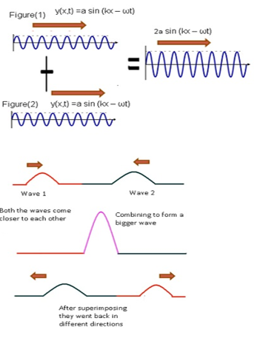
Speed Of Longitudinal Waves

Slide 55
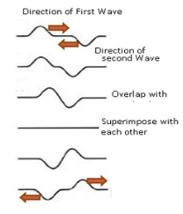
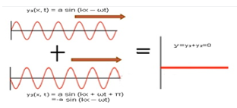
Case 2:-
Consider when the two waves are completely out of phase. i. e. ϕ = π
If wave 1 is represented by y₁ (x, t) = a sin (kx - ωt).
Wave 2 is represented by y₂ (x, t) = a sin (kx – ωt + π).
=> y₂ = a sin (π-(-kx+ ωt) => y₂ = -a sin (kx- ωt)
Therefore by superposition principle y = y₁ +y₂ = 0

Slide 56
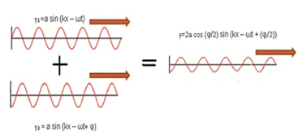
Case 3:
Consider when the two waves partially out of phase ϕ > 0; ϕ < π
If wave 1 is represented by y₁ (x, t) = a sin (kx - ωt).
Wave 2 is represented by y₂ (x, t) = a sin (kx - ωt+ ϕ).
Therefore by the principle of superposition of waves, y = y₁+ y₂
= a (sin (kx - ωt) + sin (kx – ωt + ϕ]
y = 2a cos (ϕ/2) sin (kx — ωt + (ϕ/2))
(By using the formula sin A + sin B = 2sin (A+B)/2) cos (A-B)/2)
Amplitude = 2a cos (ϕ/2) and Phase will be determined by (ϕ/2).

Slide 57
Reflected Waves
Reflection of waves
Reflection of waves is the change in the direction of a wave upon striking the interface between two materials.
When a wave strikes any interface between any two mediums the bouncing back of wave is termed as reflection of waves.
Interface can be categorised into 2 types:
Open boundary: - When a wave strikes an interface in case of open boundary it will get reflected as well as refracted.
Closed boundary or a rigid boundary: - When a wave is incident on an interface it will completely get reflected. Example:-Wave striking wall(echo)

Slide 58
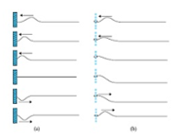
A pulse incident from the right is reflected at the left end of the string, which is tied to a wall. Note that the reflected pulse is inverted from the incident pulse,
Here the left end is tied to a ring that can slide up and down without
friction on the rod. Now the reflected pulse is not inverted by reflection.

Slide 59
Reflection at rigid boundary
Consider a string which is fixed to the wall at one end. When an incident wave hits a wall.it will exerta force on the wall.
By Newton's third law, the wall exerts an equal and opposite force of equal magnitude on the string.
Since the wall is rigid wall won't move, therefore no wave is generated at the boundary. This implies the amplitude at the boundary is 0.
As both the reflected wave and incident wave are completely out of phase at the boundary. Therefore <p=n.
Therefore, y,(x, t) = a sin (kx - ωt),
yr(x, t) = a sin (kx + wt + n) = - a sin (kx + ωt)
By superposition principle y= y, + yr =0

Slide 60
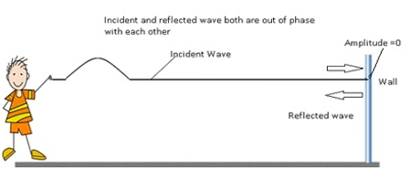
Conclusion:
The reflection at the rigid body will take place with a phase reversal of n or 180.

Slide 61
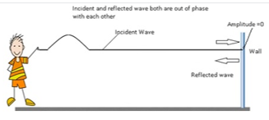
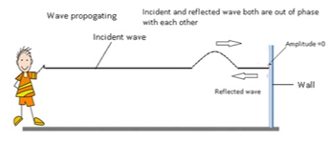
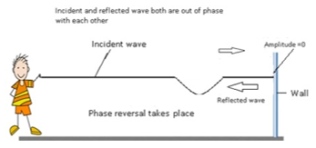
Reflected Waves

Slide 62
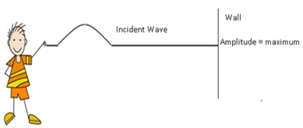
Reflection at open boundary
The reflection at an open boundary will take place without any phase change.
In this case at boundary pulse is generated. Therefore amplitude at the boundary is maximum.
This means the reflected wave and incident wave are in phase with each other. As a result the phase difference ϕ = 0.
Therefore, y₁(x, t) = a sin (kx - ωt),
y₁(x, t) = a sin (kx - ωt).By superposition principle y = y_{i} + y_{r} = 2a sin (kx - ωt)

Slide 63
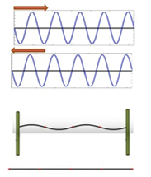
Stationary Waves
Standing (Stationary) Waves
A stationary wave is a wave which is not moving, i.e. it is at rest.
when two waves with the same frequency, wavelength and amplitude travelling in opposite directions will interfere they produce a standing wave.

Slide 64
Conditions to have a standing wave:- Two travelling waves can produce a standing wave, if the waves are moving in opposite directions and they have the same amplitude and frequency.
At certain instances when the peaks of both the waves will overlap. Then both the peaks will add up to form the resultant wave.
At certain instances when the peak of the one wave combine with the negative of the second wave. Then the net amplitude will become 0.
As a result a standing wave is produced. In case of stationary wave the wave form does not move.

Slide 65
Reflected Waves
Explanation :
Consider Is1 wave in the figure and suppose we have a rigid wall which does not move. When an incident wave hits the rigid wall it reflects back with a phase difference of π.
Consider IInd wave in the figure, when the reflected wave travels towards the left there is another incident wave which is coming towards right.
The incident wave is continuously coming come from left to right and the reflected wave will keep continuing from right to left.
At some instant of time there will be two waves one going towards right and one going towards left as a result these two waves will overlap and form a standing wave.

Slide 66
Reflected Waves
Mathematically:
Wave travelling towards left y,(x, t) = a sin (kx- ωt) and towards right y_{r}(x, t) = a sin (kx + ωt)
The principle of superposition gives, for the combined wave
y (x, 1) = y_{r} (x. t) + y_{f} (x. t) = 3 sin (kx - ωt) + a sin (kx + ωt)
y (x, t) = (2a sin kx) cos ωt (By calculating and simplifying)
The above equation represents the standing wave expression.
Amplitude = 2a sin kx.
The amplitude is dependent on the position of the particle.
The cos ωt represents the time dependent variation or the phase of the standing wave.

Slide 67
Difference between the travelling wave and stationary wave
Travelling Wave(Progressive Wave) | Stationary Wave (Standing wave)
Waveform moves. Movement of the waveform is always indicated by the movement of the peaks of the wave. | Waveform doesn't move. Peaks don't move.
Wave amplitude is same for all the elements in the medium. Denoted by 'A'. | Wave amplitude is different for different elements. Denoted by asinkx.
Amplitude is not dependent on the position of the elements of the medium. | Amplitude is dependent on the position of the elements of the medium.
y (x, t) = a sin (kx- ωt + ϕ) | y (x, t) = 2asin (kx) cos(ωt)

Slide 68
Nodes and Antinodes of Standing Wave
The amplitude of a standing wave doesn't remain the same throughout the wave,
It keeps on changing as it is a function of x.
At certain positions the value of amplitude is maximum and at certain positions the value of amplitude is 0.
Nodes: - Nodes represent the positions of zero amplitude.
Antinodes: - Antinodes represent the positions of maximum amplitude.
Nodes:-
At nodes, amplitude is 0.
In case of the standing wave amplitude is given as :- 2asinkx
=> 2asinkx = 0, => sinkx = 0, => sinkx = sin n π => kx = n π
The value of x represents position of nodes where amplitude is 0.
x = (nπ)/k... equation(i)
From the definition of k = (2π)/λ... equation(ii)
The position of nodes is represented by:-x = (n λ/2 from (i) and (ii),where n = 1,2,3...

Slide 69
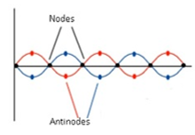
Nodes and Antinodes
Note: -Half a wavelength (λ/2) separates two consecutive nodes.
Antinodes:-
At antinodes, amplitude is maximum.
In case of the standing wave amplitude is given as:- 2asinkx
=> 2asinkx = maximum. This value is maximum only when sink x = l.
=> sin kx = sin(n+(1/2)) =>π =>kx=(n+(1/2)) =>π=>((2π)/ λ) x= (n+(1/2)) π
The position of nodes is represented by:- x= (n+(1/2))( A/2); n=0,1,2,3,4...
Note: -
Half awavelength separates two consecutive nodes.
Antinodes are located half way between pairs of nodes.

Slide 70
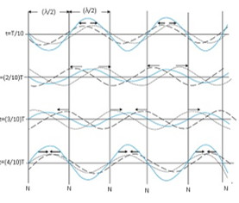
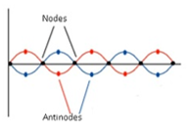
Nodes and Antinodes
Half a wave length separates two consecutive nodes.
Antinodes are located half way between pairs of nodes.
The formation of a standing wave in a stretched string. Two sinusoidal waves of same amplitude travel along the string in opposite directions. The set of pictures represent the state of displacement sat four different times. The displacement at positions marked as N is zero at all times. These positions are called nodes.

Slide 71
Nodes and Antinodes
Nodes and Antinodes: system closed at both ends
System closed at both ends means both the ends are rigid boundaries.
Whenever there is rigid body there is no displacement at the boundary. This implies at boundary amplitude is always 0.
Nodes are formed at boundary,
Standing waves on a string of length L fixed at both ends have restricted wavelength.
This means wave will vibrate for certain specific values of wavelength.
At both ends, nodes will be formed.=>Amplitude = 0.
Expression for node x =(nX)/2.This value is true when x is 0 and L.
When x = L- L= (nλ)/2 => λ = (2L)/n; n = 1, 2, 3, 4......

Slide 72
λ cannot take any value but it can take values which satisfy λ = (2L)/n this expression.
That is why we can say that the standing wave on a string which is tied on both ends has the restricted wavelength,
As wavelength is restricted therefore wavenumber is also restricted,
v = v/λ (relation between wavelength and frequency)
Corresponding frequencies which a standing wave can have is given as:
-v = (vn)/2L where v = speed of the travelling wave.
These frequencies are known as natural frequency or modes of oscillations.

Slide 73
Modes of Oscillations
v = (vn)/2L where v = speed of the travelling wave, L = length of the string, n = any natural number.
First Harmonic:-
For n = l, mode of oscillation is known as Fundamental mode.
Therefore v1 =v/(2L).This is the lowest possible value of frequency,
Therefore v₁ is the lowest possible mode of the frequency,
2 nodes at the ends and 1 antinode.
Second Harmonic:-
For n = 2, v₂ = (2v)/ (2L) =v/L
This is second harmonic mode of oscillation,
3 nodes at the ends and 2 antinodes.
Third Harmonic:-
For n = 3,v₃ = (3v)/(2L).
This is third harmonic mode of oscillation,
4 nodes and 3 antinodes.

Slide 74
Numerical
8. Problem:-Find the frequency of note emitted (fundamental note) by a string 1 m long and stretched by a load of 20 kg, if this string weighs 4.9 g. Given, g = 980 cm s⁻²?
Answer:
L = 100 cm T = 20 kg = 20x 1000x980 dyne
m = 4.9/100 = 0.049 g cm"1
Now the frequency of fundamental note produced,
v = (1/2L)/(T/m)
v = 1/ (2x100)\(20x1000x980)/(0.049)
=100Hz

Slide 75
9. Problem:- A pipe 20 cm long is closed at one end, which harmonic mode of the pipe is resonantly excited by a 430 Hzsource? Will this same source can bein resonance with the pipe, if both ends are open? Speed of sound = 340 ms⁻¹?
Answer:-
The frequency of nth mode of vibration of a pipe closed at one endis give by
vn = (2n1)v/4L
v = 340ms⁻¹; L = 20cm = 0.2m; v_{n} = 430Hz.
Therefore 430= ((2n-1) x 340)/ (4 x 0.2) => n = 1
Therefore, first mode of vibration of the pipe is excited, for open pipe since must be an integer, the same source cannot be in resonance with the pipe with both ends open.

Slide 76
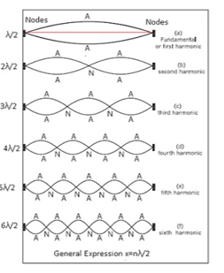
Stationary waves in a stretched string fixed at both ends. Various modes of vibration are shown

Slide 77
Nodes and Antinodes
Nodes and Antinodes: system closed at one end
For a system which is closed at one end, only one node is formed at the closed end.
Consider there is one fixed end (x = 0) and one open end (x = L), and a string is attached between these two ends.
At x = L, antinodes will be formed, This means amplitude will be maximum at this end.
Condition for formation of antinodes is x = (n + (1/2)) (λ/2) => L = (n + (1/2)) (λ/2)
=>λ= (2L)/(n+(l/2)).This expression shows that the values of wavelength is restricted.
n = 0,1,2,3...
Corresponding frequencies will be v = v/(2L) (n + 1/2) (By using v = v/λ);n=0,1,2,3,...
Modes of oscillations:-
Fundamental frequency:- Also known as First Harmonio lt corresponds to lowest possible value for n. That is n=0
The expression for fundamental frequency is v₀ = v/(2L) x 1/2 = v/(4L)

Slide 78
Nodes and Antinodes
Odd Harmonics
n = 1; v = v/(2L) (1 + (1/2)) = (3v)/(4L) = 3v₀
n = 2; v = v/(2L) (2 + (1/2)) = (5v)/(4L) = 5v₀
n = 3; v = v/(2L) (3 + (1/2)) = (7v)/(4L)=7vQ

Slide 79
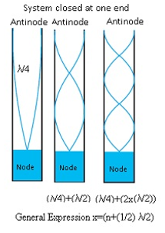
Nodes and Antinodes
For a system which is closed at one end and open at another end will get one fundamental frequency and all other odd harmonics.

Slide 80
10. Problem:- A steel rod 100 cm long is clamped at its middle. The fundamental frequency of longitudinal vibrations of the rod are given to be 2 .53 kHz. What is the speed of sound in steel?
Answer:-
Length of the steel rod, I = 100 cm = 1 m
Fundamental frequency of vibration, v = 2.53 kHz = 2.53 x 10³ Hz
When the rod is plucked at its middle, an antinode (A) is formed at its centre, and nodes (N) are formed at its two ends, as shown in the given figure.

Slide 81
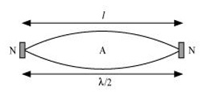
11. Problem :- A steel rod 100 cm long is clamped at its middle. The fundamental frequency of longitudinal vibrations of the rod are given to be 2.53 kHz. What is the speed of sound in steel?
Answer:-
Length of the steel rod, I = 100 cm = 1 m
Fundamental frequency of vibration, v = 2.53 kHz = 2.53 x 10³ Hz
When the rod is plucked at its middle, an antinode (A) is formed at its centre, and nodes (N) are formed at its two ends, as shown in the given figure.
The distance between two successive nodes is l/2. Therefore, l = l/2
l = 2I =2 x 1 = 2m.
The speed of sound in steel is given by the relation:

Slide 82
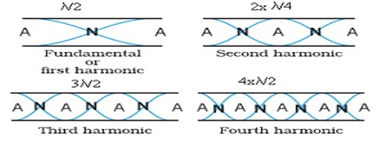
The speed of sound in steel is given by the relation:
v = vX
= 2.53 x 10³ x 2
= 5.06 x 10³ m/s
= 5.06 km/s
Open at both ends
General Expression nλ/2

Slide 83
12. Problem:- A pipe, 30.0cm long, is open al both the ends. Which harmonic mode of the pipe resonates a 1.1 kHz source? Will resonance with the same source be observed if one end of the pipe is closed? Take the speed of the sound in air as 330 ms⁻¹?
Answer:-
Fundamental Frequency: -v₁ = (V)/(2L)
Nth harmonic = v_{n} = nV7(2L); n=1( 2,3,4....
=(n x 330)/(2 x 0.3) = n x 550m/s.
v_{n} = 1.1 x 10³ Hz =1100Hz. (Source frequency given)
Therefore n x 550 =1100 => n=2. It is the second harmonic.
Fundamental Frequency: - v, = (V)/ (4L)
Odd harmonics :- (3V)/ (4L), (5V)/ (4L), (7V)/ (4L) _.
=> v₁ = v_{Y} = 275 Hz. Where v_{Y} = Fundamental Frequency
=> nv₁ = 1100 => n = 1100/275 = 4
This should correspond to 4th harmonic but 4th harmonic cannot be present as only odd harmonics are present. Therefore the same source cannot be resonated if the pipe is closed at one end.

Slide 84
Beats
Beats
Beats is the phenomenon caused by two sound waves of nearly same frequencies and amplitudes travelling in the same direction.
For example:-
Tuning of musical instruments like piano, harmonium etc. Before we start playing on these musical instruments they are set against the standard frequency. If it is not set a striking noise will keep on coming till it is set.
Mathematically
Consider only the time dependent and not the position dependent part of the wave.
s₁ = a cos ω₁ t and s₂ = a cos ω₂t; where amplitude and phase of the waves are same. but the frequencies are varying. Also considering ω₁ > ω₂.

Slide 85
When these 2 waves superimpose s = s₁ + s₂ = a[cos ω₁t + cos ω₂t]
By simplifying, 2a (cos(ω₁ - ω₂)/2)t cos(ω₁ + ω₂)/2)t)
=> ω₁ - ω₂ is very small as ω₂. Let (ω₁ - ω₂ ) = ω_{b}
=> ω₁ + ω₂ is very large. Let (ω₁ + ω₂) = ω_{a}
s = 2a cos ω_{b}t cos ω_{a}t
cos ω_{a}t will vary rapidly with time and 2acoswbt will change slowly with time.

Slide 86

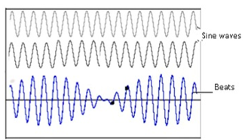
Beats
Therefore we can say 2acosω_{b}t = constant. As a result 2acosω_{b}t = amplitude as it has small angular variation

Slide 87
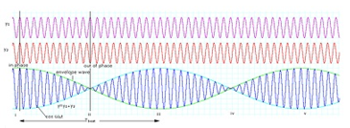
Beat Frequency
Beat frequency can be defined as the difference in the frequencies of two waves.
Consider if there is a wave of frequency ω₁ and another wave of frequency ω₂. Then the beat frequency will be ω₁ - ω₂.
it is denoted by ω
Also ω = 2πv
Therefore v_{beat} = v₁ - v₂

Slide 88
13. Problem :-Two sitar strings A and B playing the note la' are slightly out of tune and produce beats of frequency 5 Hz. The tension of the string 6 is slightly in creased and the beat frequency is found to decrease to 3 Hz. hat is the original frequency of 8 if the frequency of A is 427 Hz?
Answer:- Increase in the tension of a string in creases its frequency. If the original frequency of B (v_{B}) were greater than that of A (v_{A}), further increase In v_{B} should have resulted in anincrease in the beat frequency. But the beat frequency is found to decrease. This shows that v_{B} < v_{A}. Since v_{A} – v_{B} = 5 Hz, and v_{A}= 427 Hz, weget v_{B}= 422 Hz.

Slide 89
Doppler’s Effect
Doppler's Effect
Doppler Effect is the phenomenon of motion-related frequency change.
Consider if a truck is coming from very far off location as it approaches near our house, the sound increases and when it passes our house the sound will be maximum. And when it goes away from our house sound decreases.
This effect is known as Doppler Effect.
A person who is observing is known as Observer and object from where the sound wave is getting generated it is known as Source.
When the observer and source come nearer to each other as a result waves get compressed. Therefore wavelength decreases and frequency increases.

Slide 90
Case 1:- stationary observer and moving source
Let the source is located at a distance L from the observer.
At any time tv the source is at position P₁
Time taken by the wave to reach observer =L/v where v=speed of the sound wave.
After some time source moves to position P₀ in time T₀.
Distance between P₁ and P₀ = v_{s}T₀ where vs is the velocity of the source.
Let t2be the time taken by the second wave to reach the observer
Total time taken by the for the second wave to be sent to the observer
= T₀ + (L + v_{s}T₀)/v

Slide 91
Therefore for nth point t_{n+1} =nT₀ + (L + nv_{s}T₀)/v
=>ln time t_{n+1} the observer captures n waves.
Total time taken by the waves to travel Time period T= (t_{n+1} – t₁)/n
=T₀ + (v_{s}T₀)/v => T=T₀ (1 + v_{s}/v)
Or v= 1/T
=> v = v₀ (1 + v_{s}/v)⁻¹
By using binomial Theorem, v = v„ (1- v_{s}/v)
If the source is moving towards the observer the expression will become v = v₀ (1 + v_{s}/v)

Slide 92
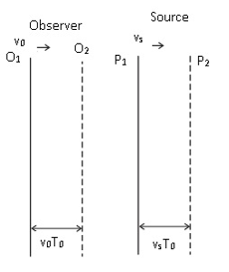
Case 2:- moving observer and stationary source
As the source is not moving therefore vg is replaced by – v₀.
Therefore v= v₀ (1 + v₀/v)

Slide 93
The observer 0 and the source S, both moving respectively with velocities v₀ and v_{s}. They are at position O₁ and P₁ at timet = 0, when the source emits the first crest of a sound, whose velocity is v with respect to the medium. After one period, t = Tn, they have moved to 02 and Prospectively through distances v₀ T₀ and v_{s} T₀, when the source emits the next crest.

Slide 94
14. Problem:- a metre -long tube opens at one end, with a movable piston at the other end. shows resonance with a fixed frequency source (a tuning fork of frequency 340 Hz) when the tube length is 25.5 cm or 79.3 cm. Estimate the speed of sound in air at the temperature of the experiment. The edge effects may be neglected.
Answer;-
Frequency of the turning fork, v = 340 Hz
Since the given pipe is attached with a piston at one end. it will behave as a pipe with one end closed and the other end open, as shown in the given figure.

Slide 95
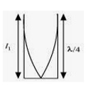
Such a system produces odd harmonics. The fundamental note in a closed pipe is given by the relation l₁ = λ/4 where,
Length of the pipe, l₁ = 25.5cm = 0.255m
Therefore M = 4 x 0.25 5= 1.02m
The speed of sound is given by the relation:
v = vλ =340 x 1.02 =346.8 m/s

Slide 96
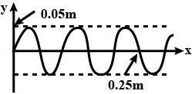
CLASS ASSIGNMENT
1. The property of a medium necessary for wave propagation is
1. Its inertia 2. Its elasticity
3. Its low resistance 4. All of above
2. If the speed of the wave shown in the figure is 330m/s in the given medium, then the equation of the wave propagating in the positive x- direction will be – (all quantities are in MKS units)
1. Y = 0.05 sin 2π (4000 t – 12.5 x) 2. Y = 0.05 sin 2π (4000 t – 122.5 x)
3. Y = 0.05 sin 2π (3300 t – 10 x) 4. Y = 0.05 sin 2π (3300 x – 10 t)

Slide 97
3. At a moment in a progressive wave, the phase of a particle executing S.H.M is Then the phase of the particle 15cm ahead and at the time
will be, if the wavelength is 60cm
1. 2. 3. zero 4.
4. A plane wave is represented by x = 1.2 sin (314t+12.56y) where x and y are distances measured along x and y direction in meter and t is time in second. This wave has
1. A wavelength of 0.25m and travels in +ve x direction
2. A wavelength of 0.25m and travels in +ve y direction
3. A wavelength of 0.5m and travels in -ve y direction
4. A wavelength of 0.5m and travels in -ve x direction

Slide 98
5. If the wave equation y = 0.08 sin (200t-x) then the velocity of the wave will be
1. 400 2. 200 3. 400 4. 200
6. The equation of a progressive wave is y=8 sin π (0.02 x-4t). If the x and y are expressed in cm and time in seconds the value of wavelength and the periodic time will be
1. 50cm, 25s 2. 0.02cm, 4s
3. 100cm, 0.5s 4. None of these
7. A progressive wave is represented by y=0.1 sin whereall the observations are in MKS system. The wave velocity will be
1. 2m/s 2. 15m/s 3. 20m/s 4. 40m/s

Slide 99
8. The equation of a progressive wave is Y= 10sin 2π (60t + 2x), where X and Y are in metre and t is in second It represents a wave whose velocity is
1. 60m/s in +X direction 2. 60m/s in -X direction
3. 30m/s in +X direction 4. 30m/s in -X direction
9. When a sound wave of frequency 300Hz passes through a medium, the maximum displacement of a particle of the medium is 0.1 cm. The maximum velocity of the particle is equal to
1. 60π cm/s 2. 30π cm/s 3.30 cm/s 4. 60 cm/s

Slide 100
10. The amplitude of a wave represented by displacement equation:
Y= sin ωt± cos ωt will be
1. 2. 3. 4.
11. Two sound waves are represented by the following equations:
y₁=10 sin (3πt-0.03x)and
y₂=5{sin(3πt-0.03x)+ cos (3πt-0.03x )}
Then the ratio of their amplitudes is given by
1. 1:1 2. 1:2 3. 2:1 4. 2:5

Slide 101
12. Two waves of same frequency but of amplitudes a and 2a respectively superimpose over each other. The intensity at a point where the phase difference is will be
1. 9a² 2. 3a² 3. a 4. 5a²
13. The phase difference between the two particles situated on both the sides of a node is
1. 0° 2. 90° 3. 180° 4. 360°
14. In stationary wave in strings
1. Energy is uniform distributed
2. Energy is maximum at nodes and minimum at antinodes
3. Energy is minimum at nodes and maximum at antinodes
4. Alternating maxima and minima of energy are produced at nodes and antinodes

Slide 102
15. S Standing waves are produced in a 10m long stretched string. If the string vibrates in 5 segments and the wave velocity is 20m/s, the frequency is
1. 2Hz 2. 4Hz 3. 5Hz 4. 10Hz
16. A string is producing transverse vibration whose equation is y=0.021 sin (x+30t), where x and y are in meter and t in second. If the linear density of the string is 1.3 x 10⁻⁴kg/m, then the tension in the string in N will be
1. 10 2. 0.5 3. 1 4. 0.117
17. If vibrations of a string are to be increased by a factor of two, then tension in the string must be made
1. Half 2. Twice 3. Four times 4. Eight times

Slide 103
18. A string in musical instrument is 50cm long and its fundamental frequency is 800 Hz. If a frequency of 1000 Hz is to be produced, then required length of string is
1. 62.5cm 2. 50cm 3. 40cm 4. 37.5cm
19. In a sinusoidal wave, the time required for a particular point to move from maximum displacement to zero displacement is 0.170 second. The frequency of the wave is
1. 1.47 Hz 2. 0.36Hz 3. 0.73Hz 4. 2.49Hz
20. A stone is dropped into a lake from a tower 500 metre high. The sound of the splash will be heard by the man approximately after
1. 11.5s 2. 21s 3. 10s 4. 14s

Slide 104
21. When sound waves travel from air to water, which of the following remains constant
1. Velocity 2. Frequency
3. Wavelength 4. All the above
22. If velocity of sound in a gas is 360m/s and the distance between a compression and the nearest rarefaction is 1m, then the frequency of sound is
1. 90Hz 2. 180Hz 3. 360Hz 4. 720Hz
23. The speed of a wave in a certain medium is 960m/s. If 3600 waves pass over a certain point of the medium in 1 minute, the wavelength is
1. 2 metre 2. 4 metre 3. 8 metre 4. 16 metre

Slide 105
24. The frequency of a tunning fork is 384 per second and velocity of sound in air is 352m/s. How far the sound has traversed while fork completes 36 vibration
1. 3m 2. 13m 3. 23m 4. 33m
25. The waves in which the particles of the medium vibrate in a direction perpendicular to the direction of wave motion is known as
1. Transverse wave 2. Longitudinal waves
3. Propagated waves 4. None of these
26. As a wave propagates choose incorrect statement:
(1) The wave intensity remains constant for a plane wave
(2) The wave intensity decreases as the inverse of the distance from the source for a spherical wave
(3) The wave intensity decreases as the inverse square of the distance from the source for a spherical wave
(4) Total intensity of the spherical wave over the spherical surface centered at the source remains constant at all times.

Slide 106
27. The ratio of the speed of sound in nitrogen gas to that in helium gas, at 300K is
1. 2. 3. 4.
28. When two sound waves with a phase difference of π/2, and each having amplitude A and frequency ω, are superimposed on each other, then the maximum amplitude and frequency of resultant wave is
1. 2. 3. 4.
29. Beats are the result of
1. Diffraction 2. Destructive interference
3. Constructive and destructive interference
4. Superposition of two waves of nearly equal frequency

Slide 107
30. The frequencies of two sound sources are 256 Hz and 260Hz. At t = 0, the intensity of sound is maximum. Then the phase difference at the time t=1/16s will be
1. Zero 2. π 3. π/2 4. π/4
31. For the stationary wave y=4sin cos (96 πt), the distance between a node and the next antinode is
1. 7.5 2. 15 3. 22.5 4. 30
32. A standing wave having 3 nodes and 2 antinodes is formed between two atoms having a distance 1.21 Å between them. The wavelength of the standing wave is
1. 1.21 Å 2. 2.42Å 3. 6.05Å 4. 3.63Å

Slide 108
33. Stationary waves of frequency 300 Hz are formed in a medium in which the velocity of sound is 1200m/s. The distance between a node and the neighboring antinode is
1. 1m 2. 2m 3. 3m 4. 4m
34. At nodes in stationary waves
1. Change in pressure and density are maximum
2. Change in pressure and density are minimum
3. Strain is zero
4. Energy is minimum
35. If the velocity of sound in air is 350m/s. Then the fundamental frequency of an open pipe of length 50cm, will be
1. 350Hz 2. 175Hz 3. 900Hz 4. 750Hz

Slide 109
36. If the velocity of sound in air is 336m/s. The maximum length of a closed pipe that would produce a just audible sound will be
1. 3.2cm 2. 4.2cm 3. 4.2cm 4. 3.2cm
37. A resonance air column of length 20cm resonates with a tuning fork of frequency 250Hz. The speed of sound in air is
1. 300m/s 2. 200m/s 3. 150m/s 4. 75m/s
38. A cylindrical tube, open at both ends, has a fundamental frequency f₀ in air. The tube is dipped vertically into water such that half of its length is inside water. The fundamental frequency of the air column now is
1. 3f₀/4 2. F₀ 3. F₀/2 4. 2f₀

Slide 110
39. Two closed pipe produce 10beats per second when emitting their fundamental nodes. If their length are in ratio of 25:26. Then their fundamental frequency in Hz, are
1. 270,280 2. 260,270 3. 260,250 4.260,280
40. Fundamental frequency of pipe is 100Hz and other two frequencies are 300Hz and 500Hz then
1. Pipe is open at both the ends 2. Pipe is closed at both the ends
3. One end open and another end is closed
4. None of the above
41. What is the base frequency if a pipe gives notes of frequencies 425, 255 and 595 and decide whether it is closed at one end or open at both ends
1. 17, closed 2. 28, closed 3. 17, open 4. 85, open

Slide 111
42. The equation of plane progressive wave propagating in positive X- direction is y=a sin 2π If the maximum particle velocity is three time the wave velocity then the wavelength of wave is
1. 2. πa 3. 4.
43. A wave travels in a medium according to the equation of displacement given by y(x,t)=0.03 sinπ(2t-0.01x) where y and x are in metre and t in second. The wavelength of the wave is
1. 200m 2. 100m 3. 20m 4. 10m

Slide 112
44. The equation of a stationary wave is Y=10 sin cos20πt. The distance between two consecutive nodes in metre is
1. 4 2. 2 3. 5 4. 8
45. The frequency of a sound wave is n and its velocity is v. If the frequency is increased to 4n, the velocity of the wave will be
1. v 2. 2ν 3. 4ν 4. ν/4

Slide 113

Thank you…

